Slide 1
Monday
November 6, 2023
LOD: Junhan An
Coach: Mark Rabbitt
Instructor: Dhruv Thota, Willie Cooper

Slide 2
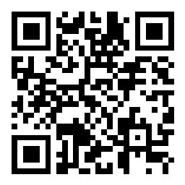
Join Slido
Join at
slido.com
#3769 584

Slide 3
Agenda
01
Roll Call
.
02
Word of the Day
03
Quote of the Day
04
Joke of the Day
05
Song of the Day
06
Ice Breakerz

Slide 4

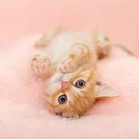
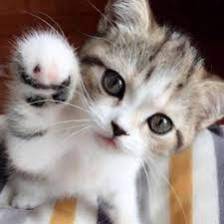
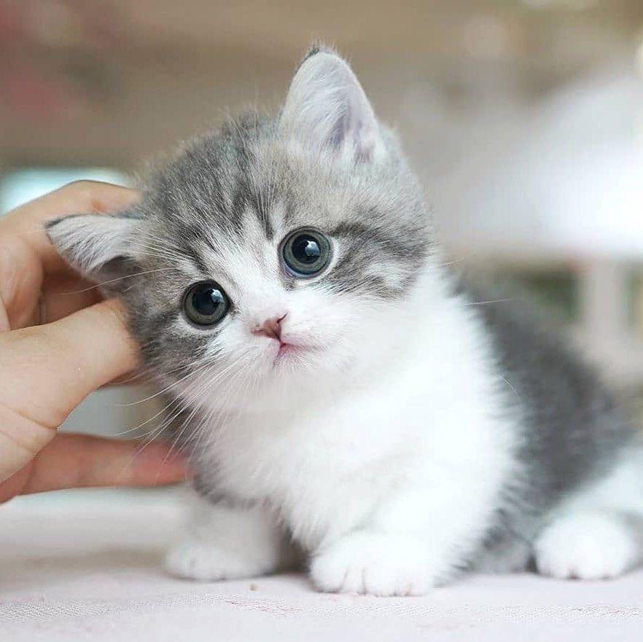
Roll Call
Junhan An
Zhou Jiang
Kasib Abdullah
Cody Phelan
LOD
Co-Leader
Time Keeper
Note Taker

Slide 5
Word of the Day

Slide 6

Sacapunta
Noun / Spanish
[ masculine ] /saka'puntas/
English Definition:
pencil sharpener
an object with a blade inside
that you use to
make pencils sharp.
Word of the
Day

Slide 7
Quote of the Day

Slide 8

This too Shall Pass
- Lady on the bus back in 2010
Origin:
(Persian: این نیز بگذرد,
romanized: īn nīz bogzarad)
is a Persian adage translated and used in several languages.

Slide 9
Joke of the Day

Slide 10
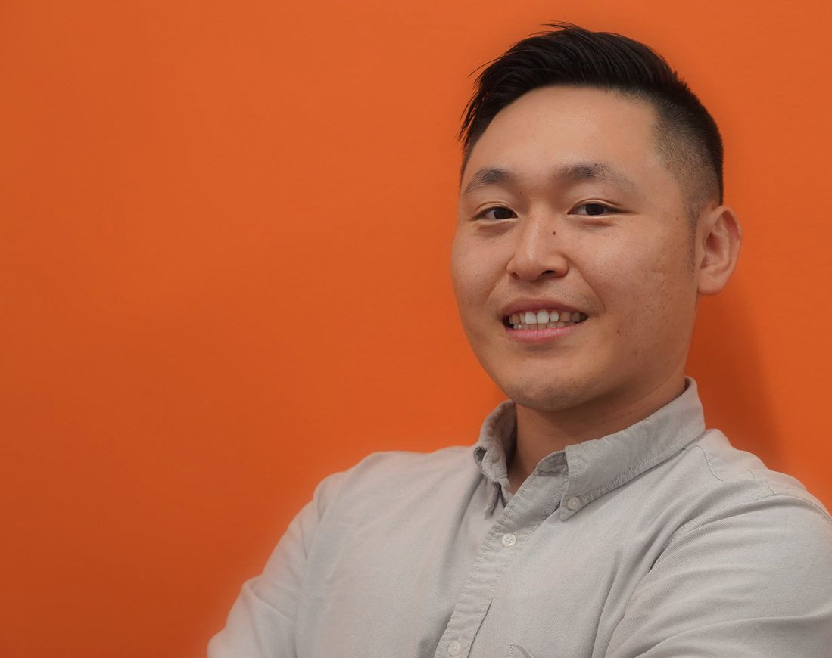
Joke of the Day

Slide 11
Song of the Day

Slide 12
Joke of the Day
Where do bad rainbows go?
They go to Prism
They get a light sentence though
So they can have time to reflect.
Take a moment and refract on this joke
In case the joke is on the outside of your spectrum of thoughts
Hope this joke brought some color to your day

Slide 13
Song of the Day

Slide 14

Set Me Free
Twice

Slide 15
Ice Breakerz

Slide 16
Ice Breakerz
Guess What I’m drawing

Slide 17
Announcements
juihinhkjnokjnjklojkloj

Slide 18
Thank You

